Slide 1
Logistics: Assignment 3 and Project Milestone 1
No class next Thursday, October 13
Assignment 3: Due Oct 17 (Monday)
Project milestone 1: Due Oct 14 (Fri)
Initial literature survey (know what other works are out there)
A plan on what you want to do for the remaining of the semester
Formalize your research question and approaches, e.g.,
Theory/simulation project: formalize your models
Data-analysis project: figure out where and how to get data and what you plan to do with it
Experiment/application project: have a prototype design and an evaluation plan
Include a timeline (weekly or biweekly) on what you plan to do
Nov 1: Midterm Project Pitch and Discussion
Nov 4: Milestone 2

Slide 2
Logistics: Peer Review Forms
The link to the form is posted on the course website
Please try to submit the form before 6pm
It might make sense to keep it open and write comments as the presentation goes.

Slide 3
Lecture 12 Additional Discussion for Prediction Markets: Automated Market Maker
Instructor: Chien-Ju (CJ) Ho

Slide 4
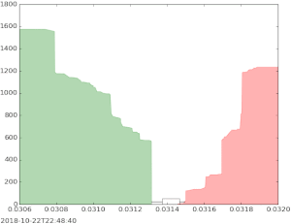
How Stock Market Works?
Common mechanism: Continuous double-auction
Buyers bid prices and quantities
Sellers ask prices and quantities
Keep bids/asks in order books
Decide price accordingly
When the market is thick (i.e., there are many buyers/sellers), double auction is a mechanism with many good properties
What if the market is thin?
Think about prediction market on events with less attention

Slide 5
Automated Market Maker
Thick vs thin markets
Enable trade even without a counter-party to sell/buy.
How to determine the price?

Slide 6
Other Usage of Automated Market Maker
The ability to deal with thin markets:
Well suited for distributed markets
It has attracted attention in blockchain
No need to maintain a central order book
AI can execute the transactions with pre-defined formulas
Possible to formally ensure some nice properties

Slide 7
Proper Scoring Rules

Slide 8
Incentivizing Truthful Reports About Probabilities
Example scenarios:
Ask a weather forecaster: will it rain tomorrow?
Ask a political researcher: will Trump be nominated for presidential election?
Ask a Microsoft employer: will the new version of Office be shipped on time?
Want to obtain forecasts about future events
How do we make sure we obtain truthful reports?

Slide 9
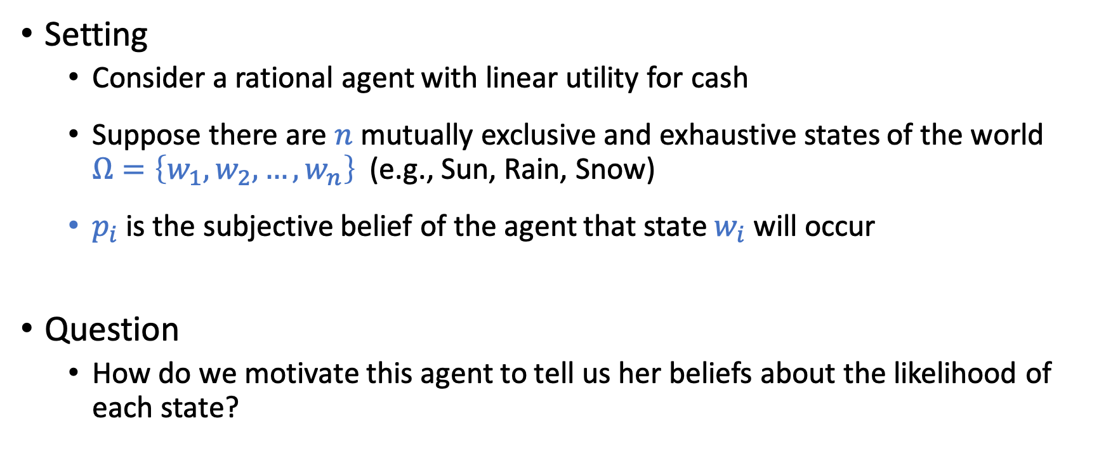
Incentivizing Truthful Reports
Setting
Consider a rational agent with linear utility for cash
Suppose there are $n$ mutually exclusive and exhaustive states of the world $Ω=\left\{w_{1},w_{2},…,w_{n}\right\}$ (e.g., Sun, Rain, Snow)
$p_{i}$ is the subjective belief of the agent that state $w_{i}$ will occur
Question
How do we motivate this agent to tell us her beliefs about the likelihood of each state?

Slide 10
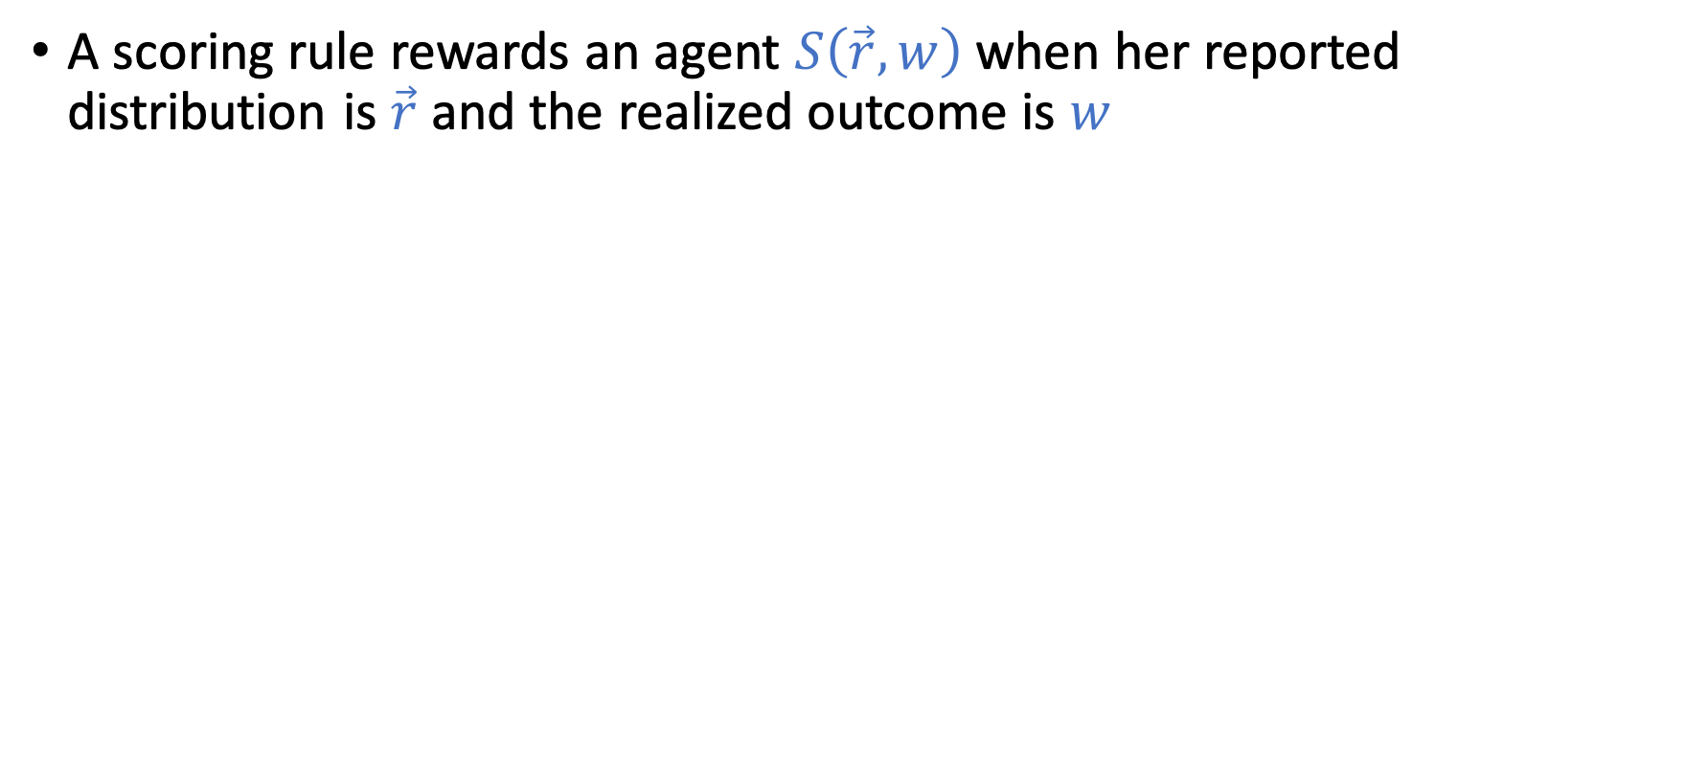
Scoring Rules
A scoring rule rewards an agent $S\left(\vec{r},w\right)$ when her reported distribution is$\vec{r}$ and the realized outcome is $w$

Slide 11
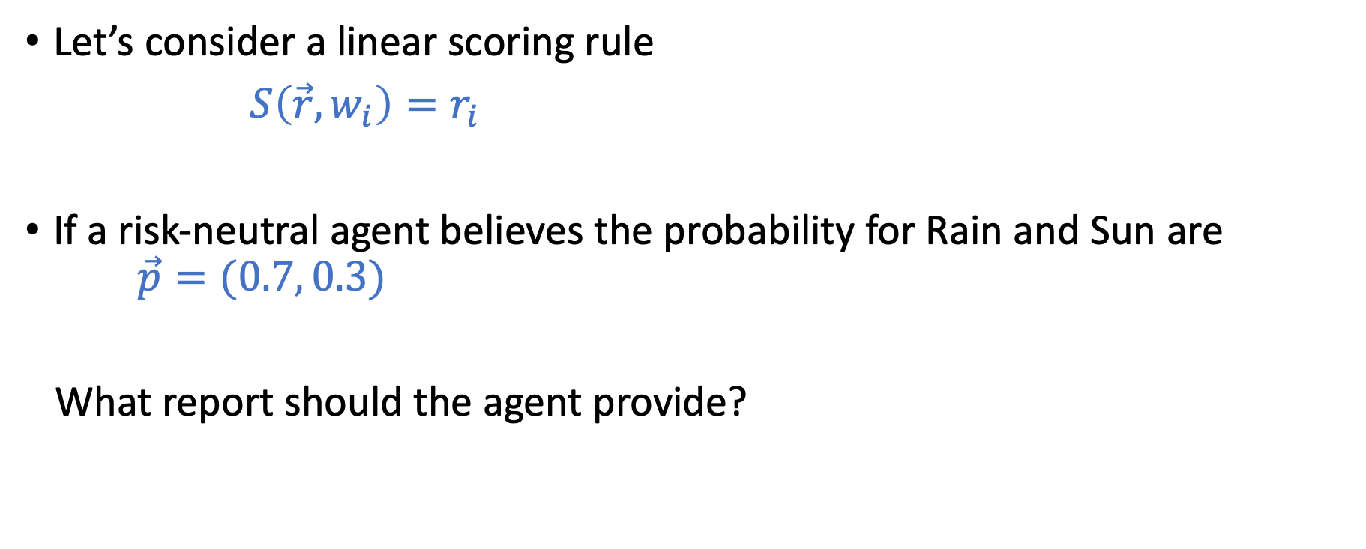
Scoring Rules
Let’s consider a linear scoring rule
$S\left(\vec{r},w_{i}\right)=r_{i}$
If a risk-neutral agent believes the probability for Rain and Sun are $\vec{p}=(0.7, 0.3)$
What report should the agent provide?

Slide 12
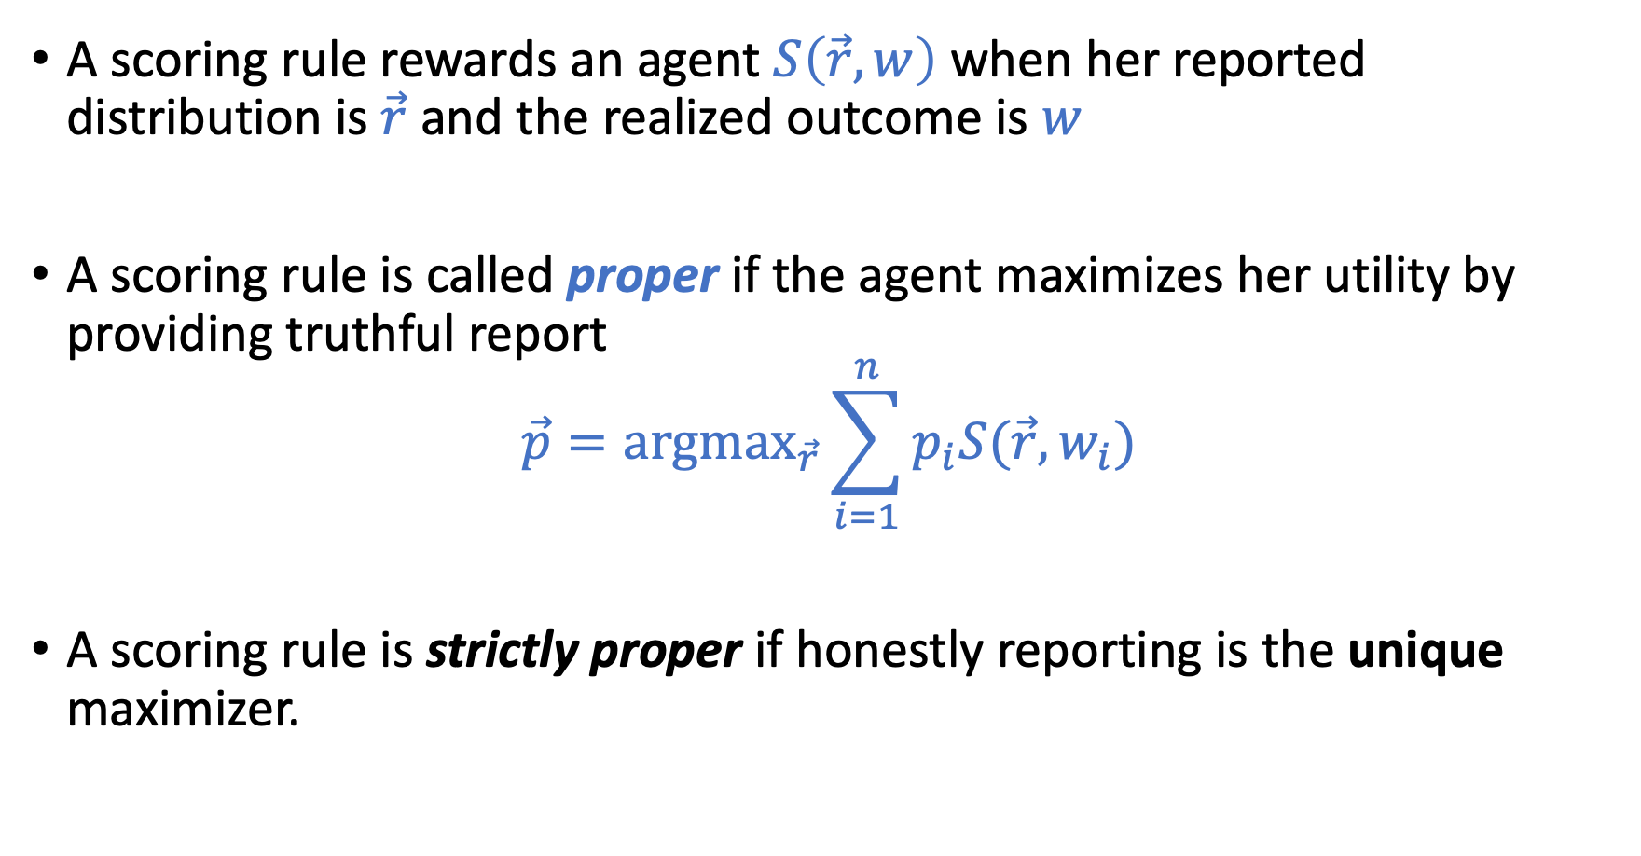
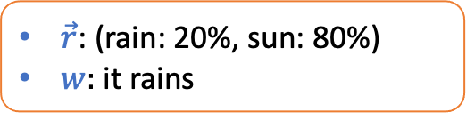
Scoring Rules
A scoring rule rewards an agent $S\left(\vec{r},w\right)$ when her reported distribution is$\vec{r}$ and the realized outcome is $w$
A scoring rule is called proper if the agent maximizes her utility by providing truthful report
$$\vec{p}=\text{argma}{\text{x}}_{\vec{r}}\sum_{i=1}^{n}{p_{i}S(\vec{r},w_{i})}$$
A scoring rule is strictly proper if honestly reporting is the unique maximizer.
$\vec{r}$: (rain: 20%, sun: 80%)
$w:$it rains

Slide 13
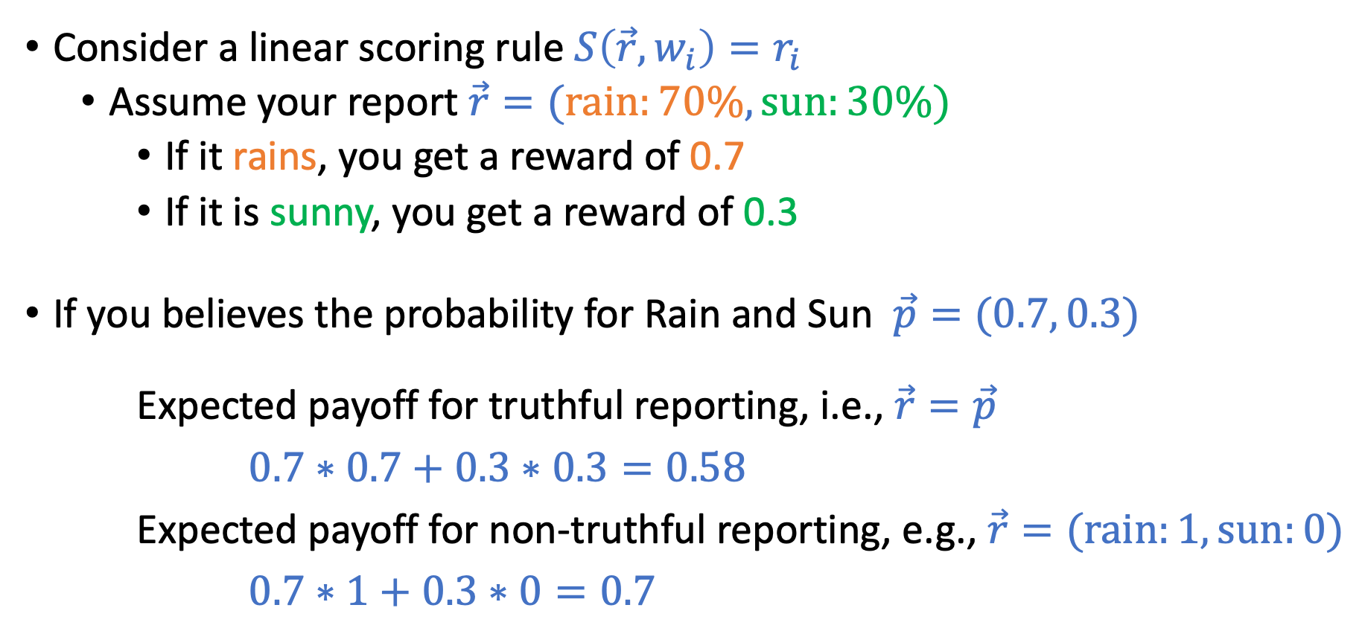
Example of Non-Proper Scoring Rule
Consider a linear scoring rule $S\left(\vec{r},w_{i}\right)=r_{i}$
Assume your report $\vec{r}=(\text{rain}:70\%, \text{sun}:30\%)$
If it rains, you get a reward of 0.7
If it is sunny, you get a reward of 0.3
If you believes the probability for Rain and Sun $\vec{p}=(0.7, 0.3)$
Expected payoff for truthful reporting, i.e., $\vec{r}=\vec{p}$
$0.7∗0.7+0.3∗$ $0.3=0.58$
Expected payoff for non-truthful reporting, e.g., $\vec{r}=(\text{rain}:1, \text{sun}:0)$
$0.7∗1+0.3∗$ $0=0.7$

Slide 14
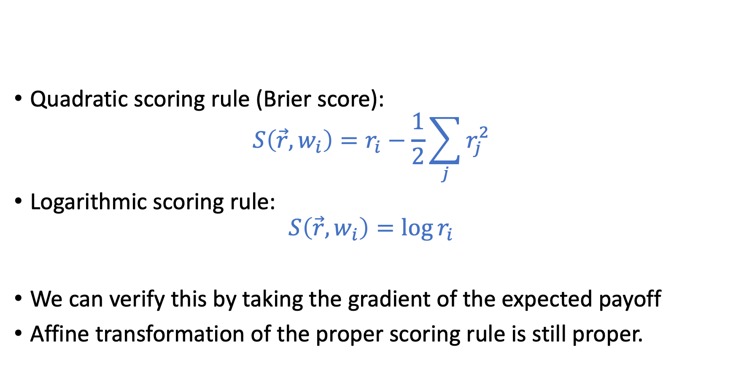
Examples of Strictly Proper Scoring Rules
Quadratic scoring rule (Brier score):
$$S\left(\vec{r},w_{i}\right)=r_{i}−\frac{1}{2}\sum_{j}{r_{j}^{2}}$$
Logarithmic scoring rule:
$$S\left(\vec{r},w_{i}\right)=\log{r_{i}}$$
We can verify this by taking the gradient of the expected payoff
Affine transformation of the proper scoring rule is still proper.

Slide 15
Back to Automated Market Maker
Goal:
Incentivize multiple agents to share their beliefs, and find a way to aggregate these beliefs into a unified prediction
1. Could use one scoring rule per agent, but not clear how to aggregate
2. Market itself is an aggregation mechanism (use final price as the prediction). However, standard stock-market-style trading might encounter issues for less popular predictions (market is too thin).

Slide 16
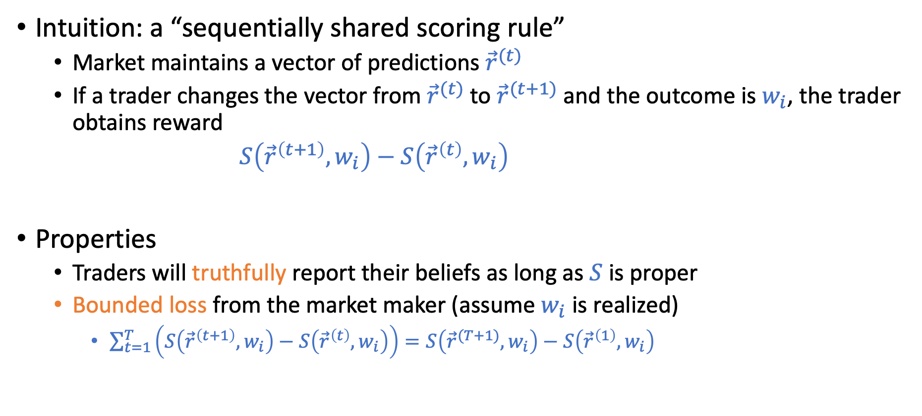
Market Scoring Rules [Hanson. 2007]
Intuition: a “sequentially shared scoring rule”
Market maintains a vector of predictions ${\vec{r}}^{(t)}$
If a trader changes the vector from ${\vec{r}}^{(t)}$ to ${\vec{r}}^{(t+1)}$ and the outcome is $w_{i}$, the trader obtains reward
$S\left({\vec{r}}^{\left(t+1\right)},w_{i}\right)−S\left({\vec{r}}^{\left(t\right)},w_{i}\right)$
Properties
Traders will truthfully report their beliefs as long as $S$ is proper
Bounded loss from the market maker (assume $w_{i}$ is realized)
$\sum_{t=1}^{T}{\left(S\left({\vec{r}}^{\left(t+1\right)},w_{i}\right)−S\left({\vec{r}}^{\left(t\right)},w_{i}\right)\right)=S\left({\vec{r}}^{(T+1)},w_{i}\right)−S\left({\vec{r}}^{\left(1\right)},w_{i}\right)}$

Slide 17
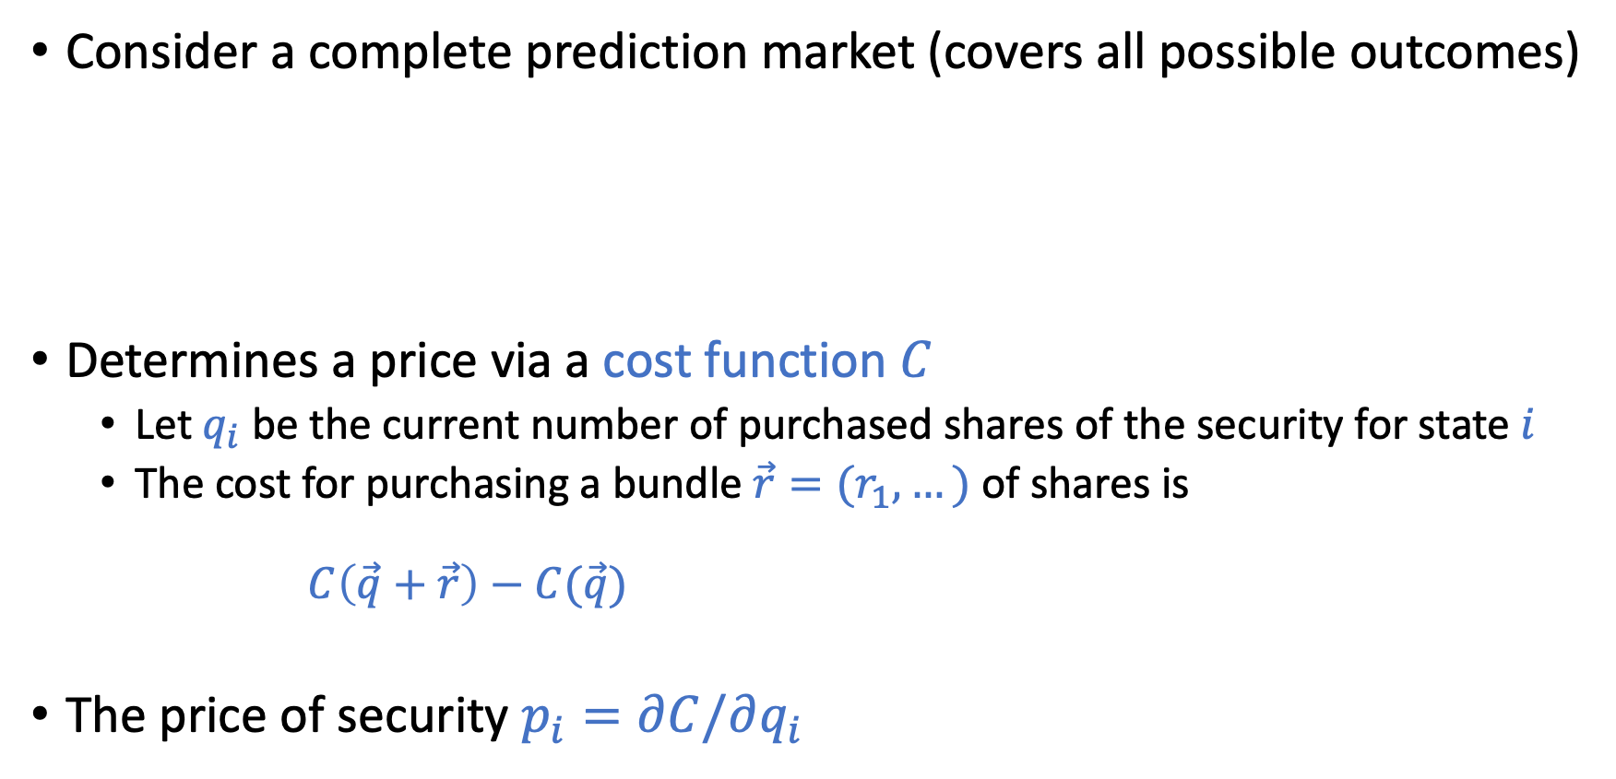
Cost-Function Based Market Maker
Consider a complete prediction market (covers all possible outcomes)
Determines a price via a cost function $C$
Let $q_{i}$ be the current number of purchased shares of the security for state $i$
The cost for purchasing a bundle $\vec{r}=(r_{1},…)$ of shares is $C\left(\vec{q}+\vec{r}\right)−C(\vec{q})$
The price of security $p_{i}=∂C/∂q_{i}$
Prediction

Slide 18
Cost-Function Based Market Maker
Another way to look at the connection between cost and price
Price is the derivative of cost
Cost is the integral of price
There is an equivalency to market scoring rules Logarithmic Market Scoring Rules for Modular Combinatorial Information Aggregation. Hanson. Journal of Prediction Markets 2007.

Slide 19
Cost-Function Based Market Maker
How to determine the cost function (or the price function)?
Want the market maker to have ”nice” properties:
Existence of instantaneous prices. C must be continuous and differentiable
No arbitrage: Can’t buy a bundle r with a guaranteed positive profit regardless of outcome
Expressiveness: A trader must always be able to set the market prices to reflect his beliefs
Information incorporation: Purchase of a bundle should not decrease its price
And others…

Slide 20
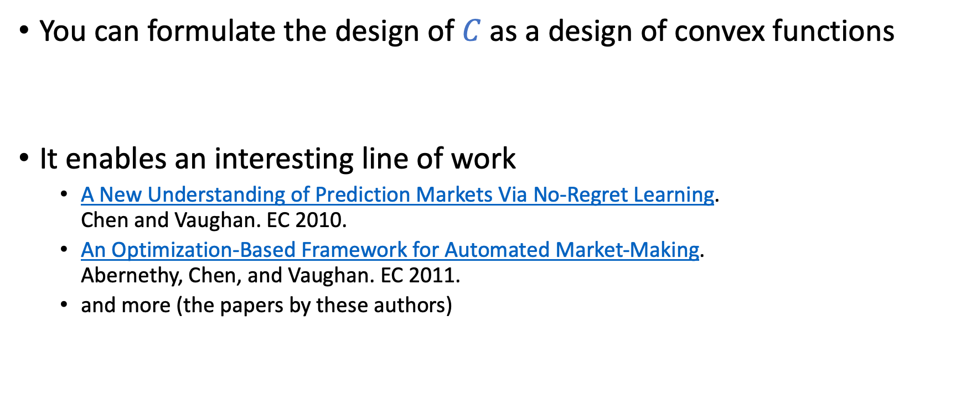
Connection to Convex Optimization
You can formulate the design of $C$ as a design of convex functions
It enables an interesting line of work
A New Understanding of Prediction Markets Via No-Regret Learning. Chen and Vaughan. EC 2010.
An Optimization-Based Framework for Automated Market-Making. Abernethy, Chen, and Vaughan. EC 2011.
and more (the papers by these authors)

Slide 21
Other Interesting Questions and Explorations
Combinatorial markets

Slide 22
Other Interesting Questions and Explorations
Incentives/Manipulations in Prediction Markets
Information aggregation
Assume you have private information others don’t know
Should you report as soon as possible or wait till later?
Bluffing:
People are influence by the market price
Can I bluff to mislead others for future gains?
Outside incentives and manipulation
Assume the price has impacts to the real outcome (e.g., election)
People might want to manipulate the market
…

Slide 23
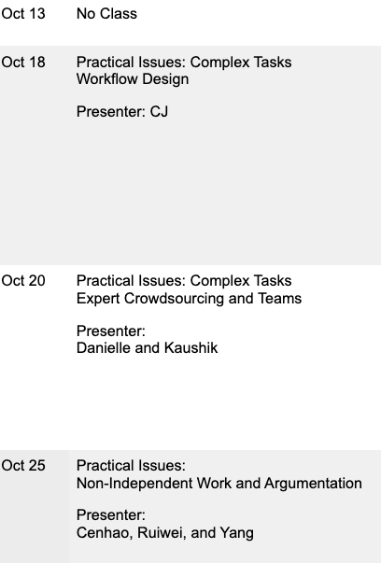
Next 3 Lectures

Slide 24
Proper Scoring Rules

Slide 25
Incentivizing Truthful Reports About Probabilities
Example scenarios:
Ask a weather forecaster: will it rain tomorrow?
Ask a political researcher: will Trump win 2020 election?
Ask a Microsoft employer: will the new version of Office be shipped on time?
Want to obtain forecasts about future events
How do we make sure we obtain truthful reports?

Slide 26
Incentivizing Truthful Reports
Setting
Consider a rational agent with linear utility for cash
Suppose there are $n$ mutually exclusive and exhaustive states of the world $Ω=\left\{w_{1},w_{2},…,w_{n}\right\}$ (e.g., Sun, Rain, Snow)
$p_{i}$ is the subjective belief of the agent that state $w_{i}$ will occur
Question
How do we motivate this agent to tell us her beliefs about the likelihood of each state?

Slide 27
Scoring Rules
A scoring rule rewards an agent $S\left(\vec{r},w\right)$ when her reported distribution is$\vec{r}$ and the realized outcome is $w$

Slide 28
Scoring Rules
Let’s consider a linear scoring rule
$S\left(\vec{r},w_{i}\right)=r_{i}$
If a risk-neutral agent believes the probability for Rain and Sun are $\vec{p}=(0.7, 0.3)$
What report should the agent provide?

Slide 29
Scoring Rules
A scoring rule rewards an agent $S\left(\vec{r},w\right)$ when her reported distribution is$\vec{r}$ and the realized outcome is $w$
A scoring rule is called proper if the agent maximizes her utility by providing truthful report
$$\vec{p}=\text{argma}{\text{x}}_{\vec{r}}\sum_{i=1}^{n}{p_{i}S(\vec{r},w_{i})}$$
A scoring rule is strictly proper if honestly reporting is the unique maximizer.

Slide 30
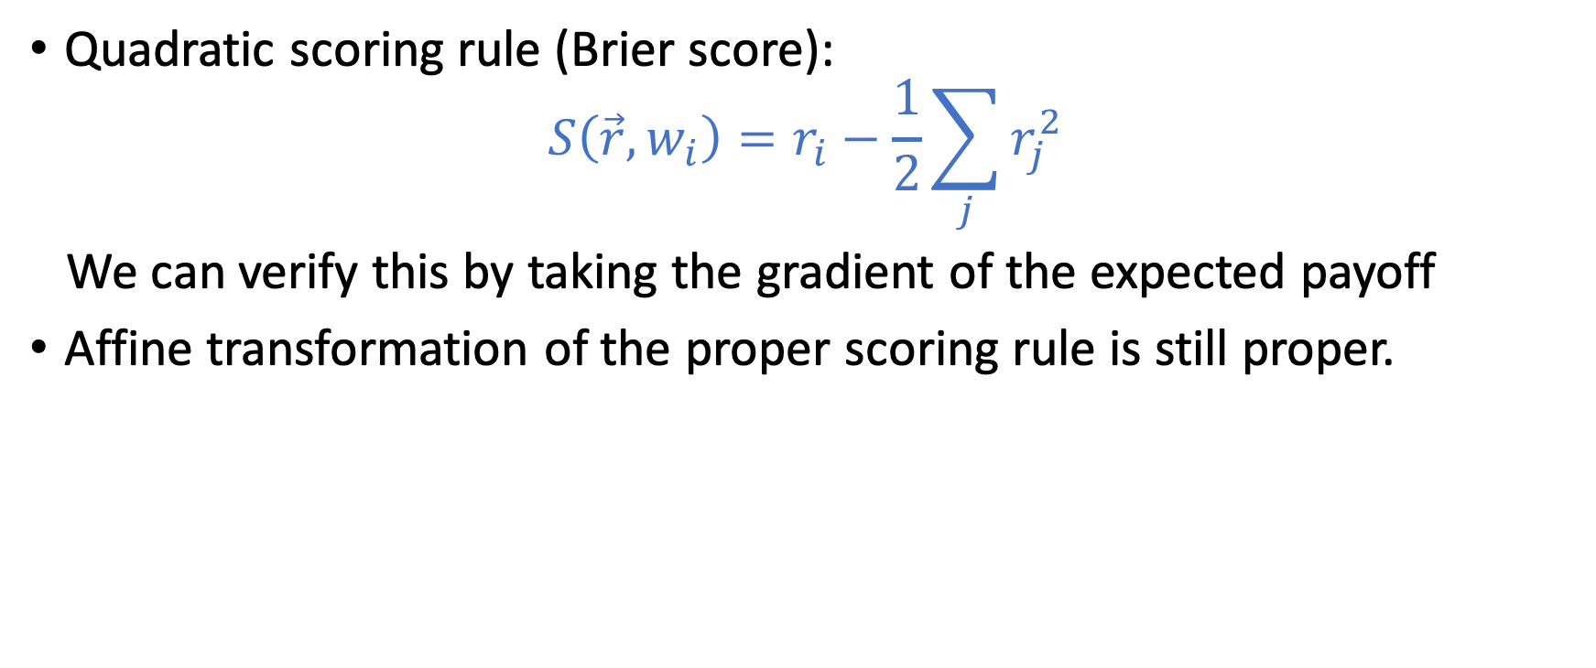
Examples of Strictly Proper Scoring Rules
Quadratic scoring rule (Brier score):
$$S\left(\vec{r},w_{i}\right)=r_{i}−\frac{1}{2}\sum_{j}{r_{j}^{2}}$$
We can verify this by taking the gradient of the expected payoff
Affine transformation of the proper scoring rule is still proper.

Slide 31
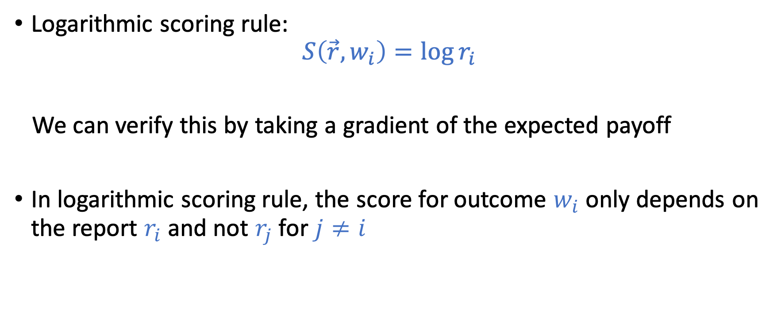
Examples of Strictly Proper Scoring Rules
Logarithmic scoring rule:
$$S\left(\vec{r},w_{i}\right)=\log{r_{i}}$$
We can verify this by taking a gradient of the expected payoff
In logarithmic scoring rule, the score for outcome $w_{i}$ only depends on the report $r_{i}$ and not $r_{j}$ for $j≠i$

Slide 32
More examples?
How do we construct a strictly proper scoring rule?
How many strictly proper scoring rules are there?

Slide 33
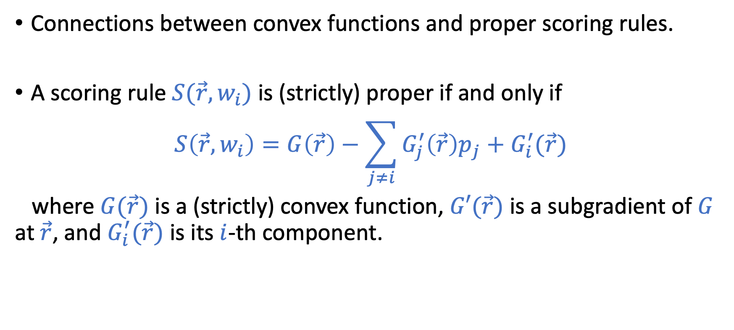
Characterization of Proper Scoring Rules
Connections between convex functions and proper scoring rules.
A scoring rule $S(\vec{r},w_{i})$ is (strictly) proper if and only if
$$S\left(\vec{r},w_{i}\right)=G\left(\vec{r}\right)−\sum_{j≠i}{G_{j}^{′}\left(\vec{r}\right)p_{j}+G_{i}^{′}(\vec{r})}$$
where $G(\vec{r})$ is a (strictly) convex function, $G′(\vec{r})$ is a subgradient of $G$ at $\vec{r}$, and $G_{i}^{′}(\vec{r})$ is its $i$-th component.
Section 3.1 of Strictly Proper Scoring Rules, Prediction, and Estimation by Gneiting and Raftery.

Slide 34
Connection to Prediction Market

Slide 35
Connection to Prediction Markets
Goal:
Incentivize multiple agents to share their beliefs, and find a way to aggregate these beliefs into a unified prediction
1. Could use one scoring rule per agent, but not clear how to aggregate
2. Market itself is an aggregation mechanism (use final price as the prediction). However, standard stock-market-style trading might encounter issues for less popular predictions (market is too thin).

Slide 36
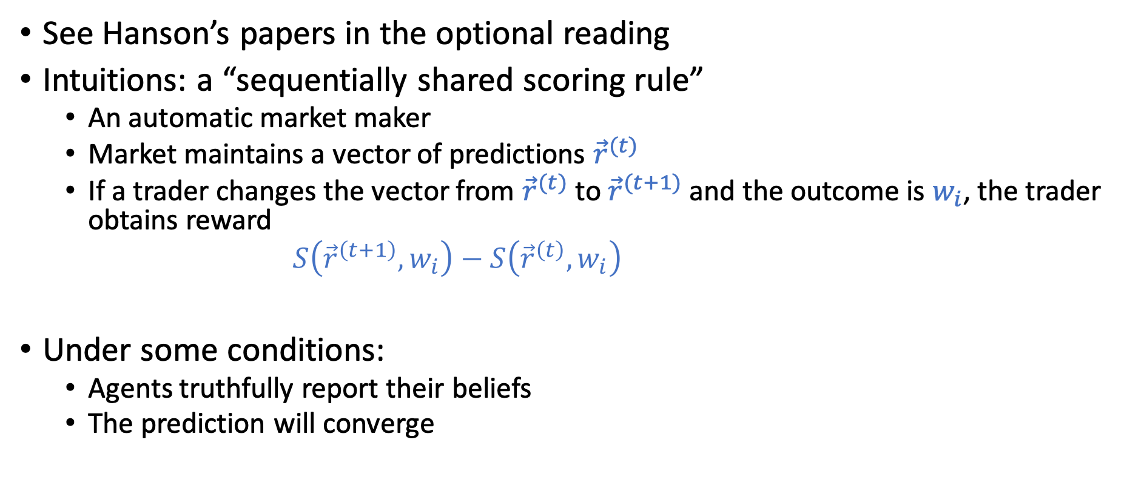
Market Scoring Rules
See Hanson’s papers in the optional reading
Intuitions: a “sequentially shared scoring rule”
An automatic market maker
Market maintains a vector of predictions ${\vec{r}}^{(t)}$
If a trader changes the vector from ${\vec{r}}^{(t)}$ to ${\vec{r}}^{(t+1)}$ and the outcome is $w_{i}$, the trader obtains reward
$S\left({\vec{r}}^{\left(t+1\right)},w_{i}\right)−S\left({\vec{r}}^{\left(t\right)},w_{i}\right)$
Under some conditions:
Agents truthfully report their beliefs
The prediction will converge

Slide 37
Market Scoring Rules
The connection to convex optimization opens up an interesting line of research in the design of efficient market maker…

